Slide 1
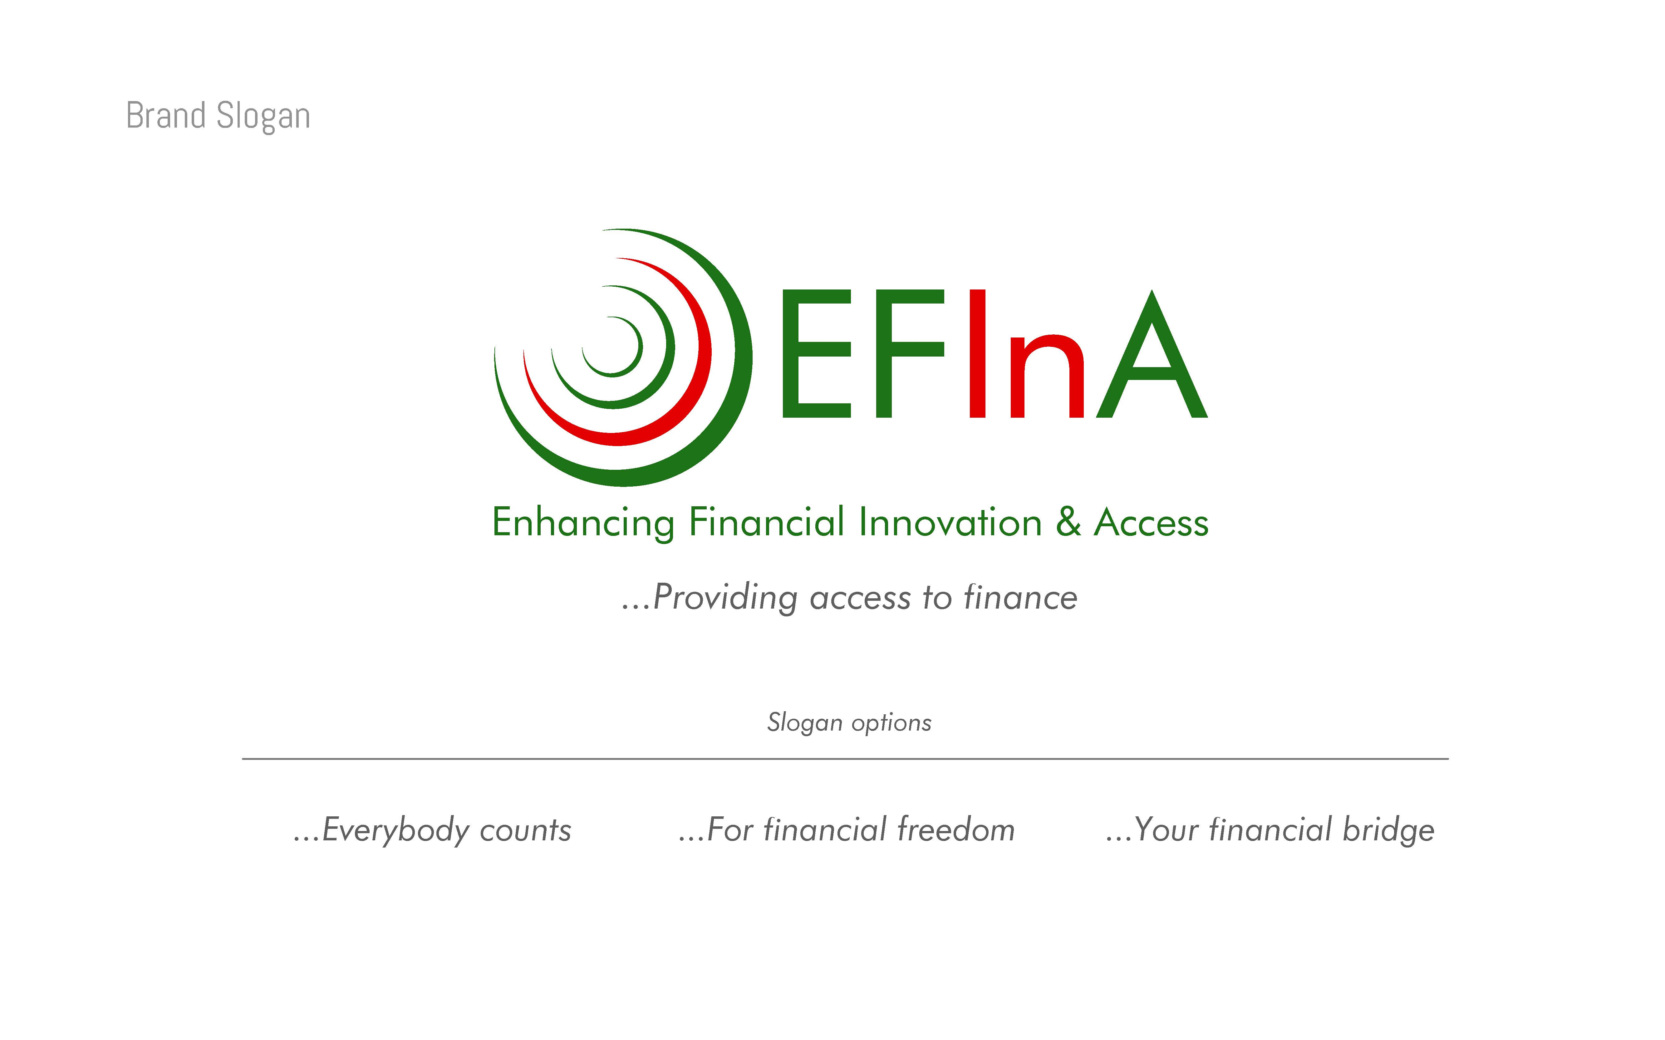

Impact of COVID-19 on
Financial Services Agents
Key Findings
June 2020

Slide 2
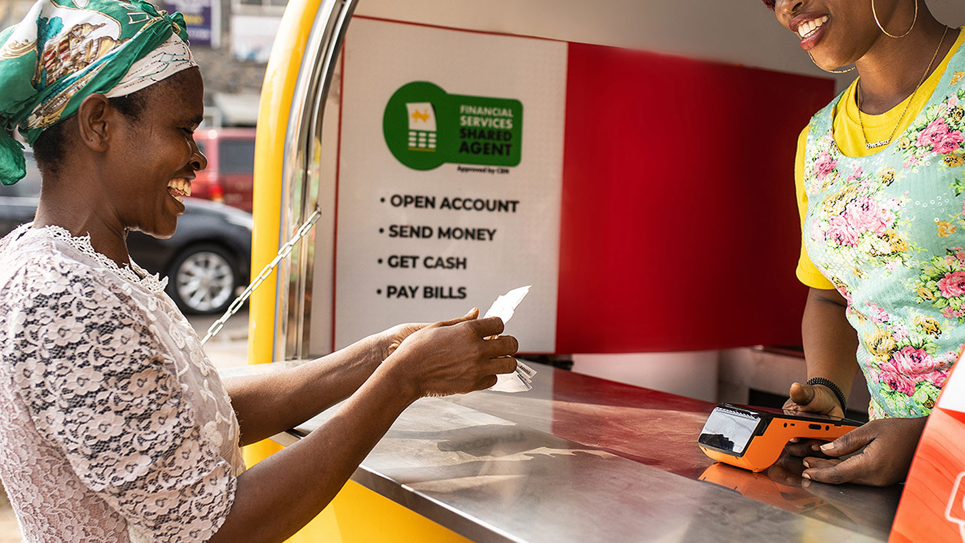
About EFInA
Enhancing Financial Innovation & Access (EFInA) is a financial sector development organisation that promotes financial inclusion in Nigeria. Established in late 2007, our mission is to make the Nigerian financial system work better, especially for the poor. EFInA works through four pillars:
Research
Innovation
Digital Finance
Capacity Building & Advocacy
EFInA is funded by UK Government’s Department for International Development (DFID) and the Bill & Melinda Gates Foundation.

Slide 3
CONTENT
Introduction
1
Background & Objectives
Methodology
Detailed Findings
2
Impact of Covid-19 on Agents’ operation
Summary & Recommendations
3
Recommendations
Notes:
3

Slide 4
BACKGROUND & METHODOLOGY
Research Objectives
Understand the impact of the COVID-19 pandemic on financial services agent's business
Understand how financial service agents are managing their businesses in this period
Are agents receiving the required support from their principals? If yes, how useful is the support currently provided?
Understand the potential for agents to support the fight against COVID-19
Research Methodology
The COVID-19 impact survey covers a sample of 735 agents from the Financial Services Agents 2020 survey who indicated willingness to participate in subsequent surveys
Data collection was done in May 2020 using Computer Assisted Telephone Interviews
This methodology involved the use of the respondent’s contact phone number.
4
Notes:
4

Slide 5
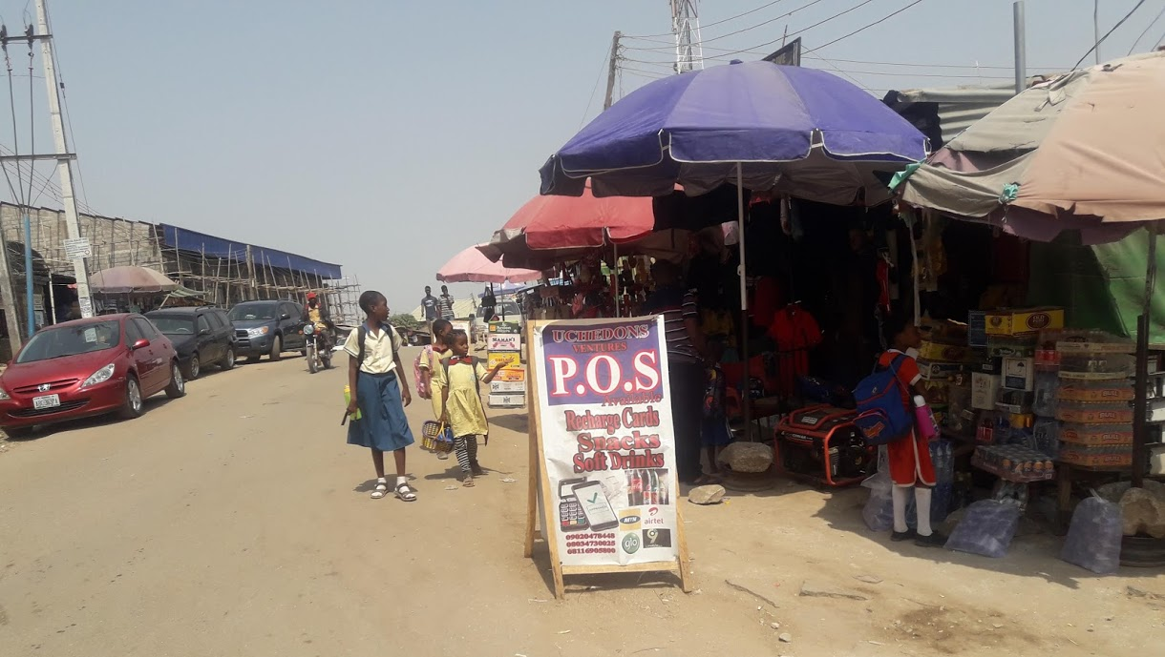
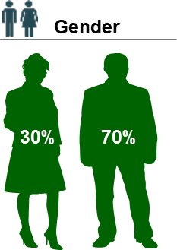
Spread across the regions but mostly found in the urban regions.
Location Classification (FSAS)
Region
Sokoto
Borno
Kebbi
Katsina
Yobe
Zamfara
Jigawa
Kano
Bauchi
Niger
Kaduna
Gombe
Adamawa
Kwara
Plateau
Sample
FCT
Taraba
Oyo
Nassarawa
Location | COVID Impact
Abuja | 88
Niger | 40
Bauchi | 40
Gombe | 37
Kaduna | 64
Kano | 98
Abia | 33
Anambra | 24
Delta | 50
Rivers | 34
Lagos | 179
Ogun | 48
Total sample | 735
Kogi
Osun
Ekiti
Benue
Ogun
Ondo
Edo
Enugu
Cross River
Lagos
Delta
Anambra
Ebonyi
Imo
Abia
Rivers
Akwa Ibom
Bayelsa
Base: 1618
5
Notes:
5

Slide 6

CONTENT
Introduction
1
Background & Objectives
Methodology
Detailed Findings
2
Impact of Covid-19 on agents’ operation
Summary & Recommendations
3
Recommendations

Slide 7






High awareness level and understanding of Coronavirus is seen amongst the contacted financial agents. This is no surprise as about 82% of Nigerians get information on COVID-19 multiple times a day through different sources¹
Measures taken towards customer safety
98%
86%
24%
15%
Aware of Coronavirus
Ensure customers wash or sanitize hands before entering the store.
Limit the number of customers inside the store at a time
Educating employees/customers on how to stay safe
Measures taken towards Self & Employees
72%
78%
25%
18%
Afraid of getting infected
Use face masks self & employees
Use hand gloves to operate POS machine or other agents related functions
Avoid Shaking hands
Base: n=735
Q1. Are you aware of Corona Virus Disease 2019? [SA]
Q2. What do you understand about Corona Virus Disease 2019 / COVID-19? VERBATIM RESPONSE
¹Source: Impact of COVID-19 on consumer behavior Nigeria report 2020

Slide 8
Poor support received from providers/principals so far. Only 8% claimed to have received support from FSPs since the pandemic began.
First Bank (First Monie), MTN, OPay, Airtel & Mimo(Mkudi) top the list of principals who have provided support .
Principals Providing Support
8%
Have Received Support From Providers
Base: n= 631
Q4. Have you received any kind of support from the service providers you work for since the Coronavirus / COVID-19 pandemic began?
Q4a. From which service providers have you received support? MULTIPLE RESPONSE. n=53 (caution based on small sample)
8
Notes:
8

Slide 9

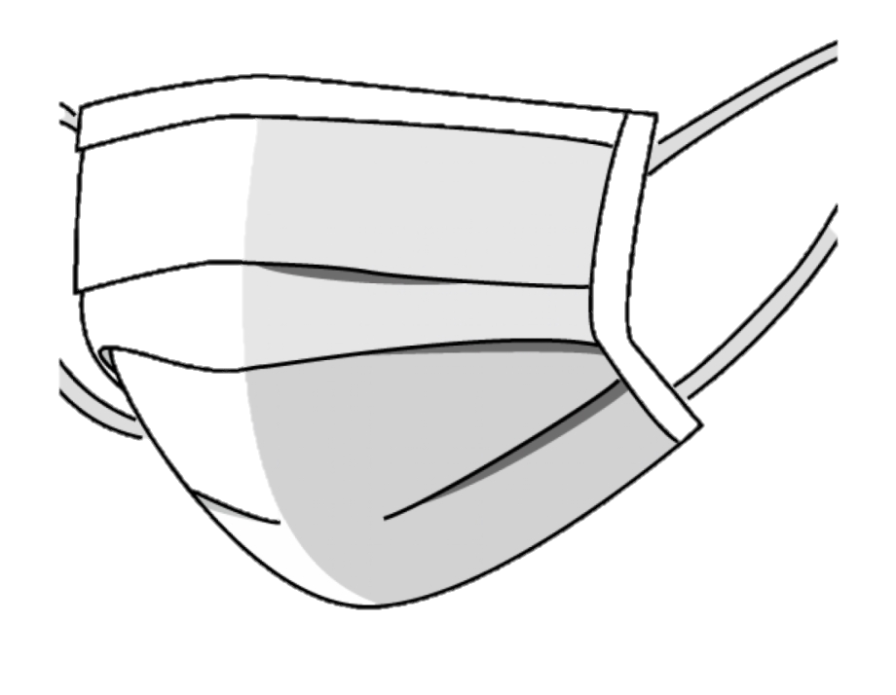
Required support at this time is skewed towards items required to survive the pandemic - safety materials (58%) and cash advances (35%), with current support levels not sufficient
Others(received sms educating them about the virus, food items, free data/airtime etc (39%)
Support Received from Principals
47%
3%
3%
2%
2%
2%
Safety materials
Training during the pandemic
Cash advances/credit
Rebates/reduction in charges
Physical visits to business
Increase commission %
About 37% of the agents mentioned Palliatives such as financial aids & Food items, Improve network for smooth transactions, resolve queries in time)
Support Needed from Principals
58%
35%
6%
4%
4%
3%
Safety materials
Cash advances/credit
Training during the pandemic
Rebates/reduction in charges
Increase Commission %
Branding materials
Base: n=631
Q5. What kind of support have you received from your service providers? (n=49) (caution based on small sample)
Q8. What kind of support would you like to receive from your service provider during this period? (n=582)

Slide 10

Over 70% of the agents who received support are satisfied with the level of support received. However more can be done towards improving the level of support given to the agents.
Overall Satisfaction Level
What can be done to improve Support received from providers?
4%
Very Dissatisfied
5%
Dissatisfied
14%
Neither Satisfied nor dissatisfied
38%
Satisfied
38%
Very Satisfied
Base: n=53 (caution based on small sample)
Q6. Can you please tell me how satisfied you are with the support given by your service provider?
Q7. What can be done to improve on the support that you have received/ are receiving from your service provider? (n=12**)

Slide 11
80% of agents’ businesses have been negatively impacted by the pandemic
41%
39%
4%
11%
5%
Business is much worse
Business is slightly worse
Business is still the same
Business is slightly better
Business is Much Better
Last agent transaction performed
71%
15%
10%
3%
Even though business is deeply impacted by the virus, they are still trading.
The more reason why support is required not only to keep up with the business but to cater to their family needs.
Past
30Days
Past
90Days
Yesterday
Past 7 Days
Base: n=631
Q9. How has your agency business been affected since the Corona virus / COVID-19 pandemic started? SA.
Q10. When did you last perform a transaction as a financial service agent? SA.

Slide 12
Limited hours of operation and low patronage have impacted monthly income of 89% of agents. Current monthly earning is less than previous earning by almost 50%.
Monthly Income _ Pre-Pandemic Period
Monthly Income _ Pandemic Period
54,662 NGN
27,944
NGN
89%
Monthly Income has changed since the pandemic
Typical Income (Avg)
Income Per Month
(Avg)
Price Charged to Customers
Those who have increased price are likely to be part of those who have gained more customers due to the restriction of movement. And those who wish to make more money during this period.
.
Increased
Mainly as a result of customers complaints of high charges, inability to pay the price charged due to cases of low/no income during the pandemic. In order to accommodate the customers the agents tend to perform the transaction at a lower price or for free
Remained the same
Decreased
Base: n=735
Q12 Could you tell us how much total income you make per typical month from your agent banking service?
Q13a. Has the monthly income changed since the pandemic (COVID 19/Corona virus) began?
Q13b. If YES? How much do you make now? (n=657)
Q15a. Has there been any change in the price you charge to customers? (Has it increased, decreased or remained the same)

Slide 13
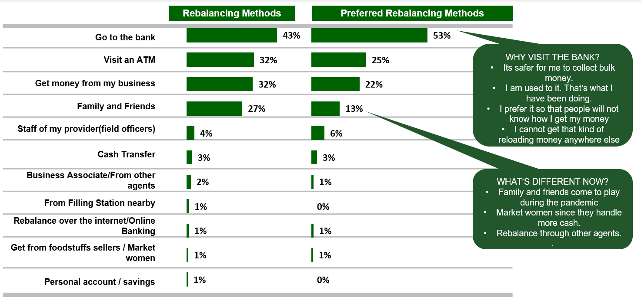
Banks, ATM & money from own business remains the preferred methods of rebalancing at this time. Banks are generally perceived as being safe and reliable.
Base: n=735
Q14a. What methods do you use in managing your rebalancing of float since the pandemic started? (Multiple Response)
Q14b. What methods/options of rebalancing would you prefer? (Multiple Response)

Slide 14
Personal savings and other sources of income have been instrumental to agent’s resilience to the pandemic
COPING MECHANISM (%)
Support from the government during this period has been poor likewise from the principals.
Base: n=63 (Those whose price/charges have decreased). (caution based on small sample)
Q15b.How have you and your household been coping financially since the Corona virus / COVID-19 pandemic started? MA.

Slide 15
Despite bad business conditions and little or no support received from principals, the agent are still willing to render support hence should be activated to aid the fight against the spread.
How Can You Support the fight against the Corona Virus?
The agents are already providing support by adhering to safety measures and also educating customers/community about the virus, they have done this as part of the measures taken since the pandemic started.
More can be done if only they receive the necessary support from their principals.
Willing to be part of the support system in the fight against the Corona Virus disease
Base: n=735
Q18. Are you willing to be part of a support system in the fight against the Corona virus disease/ COVID-19 SA
Q19. In your opinion, how can you support the fight against the Corona virus disease/COVID-19?

Slide 16
Introduction
1
Background & Objectives
Methodology
Detailed Findings
2
Impact on agent’s business
Summary & Recommendations
3
Summary and Recommendations

Slide 17
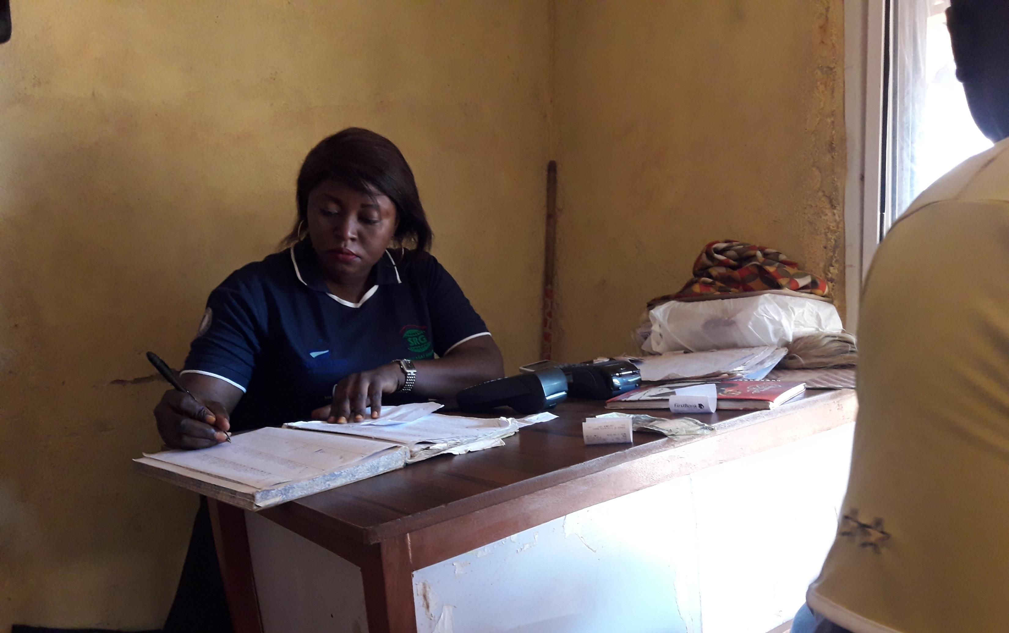
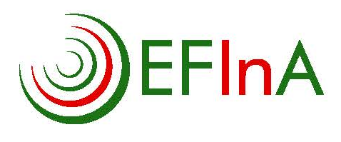
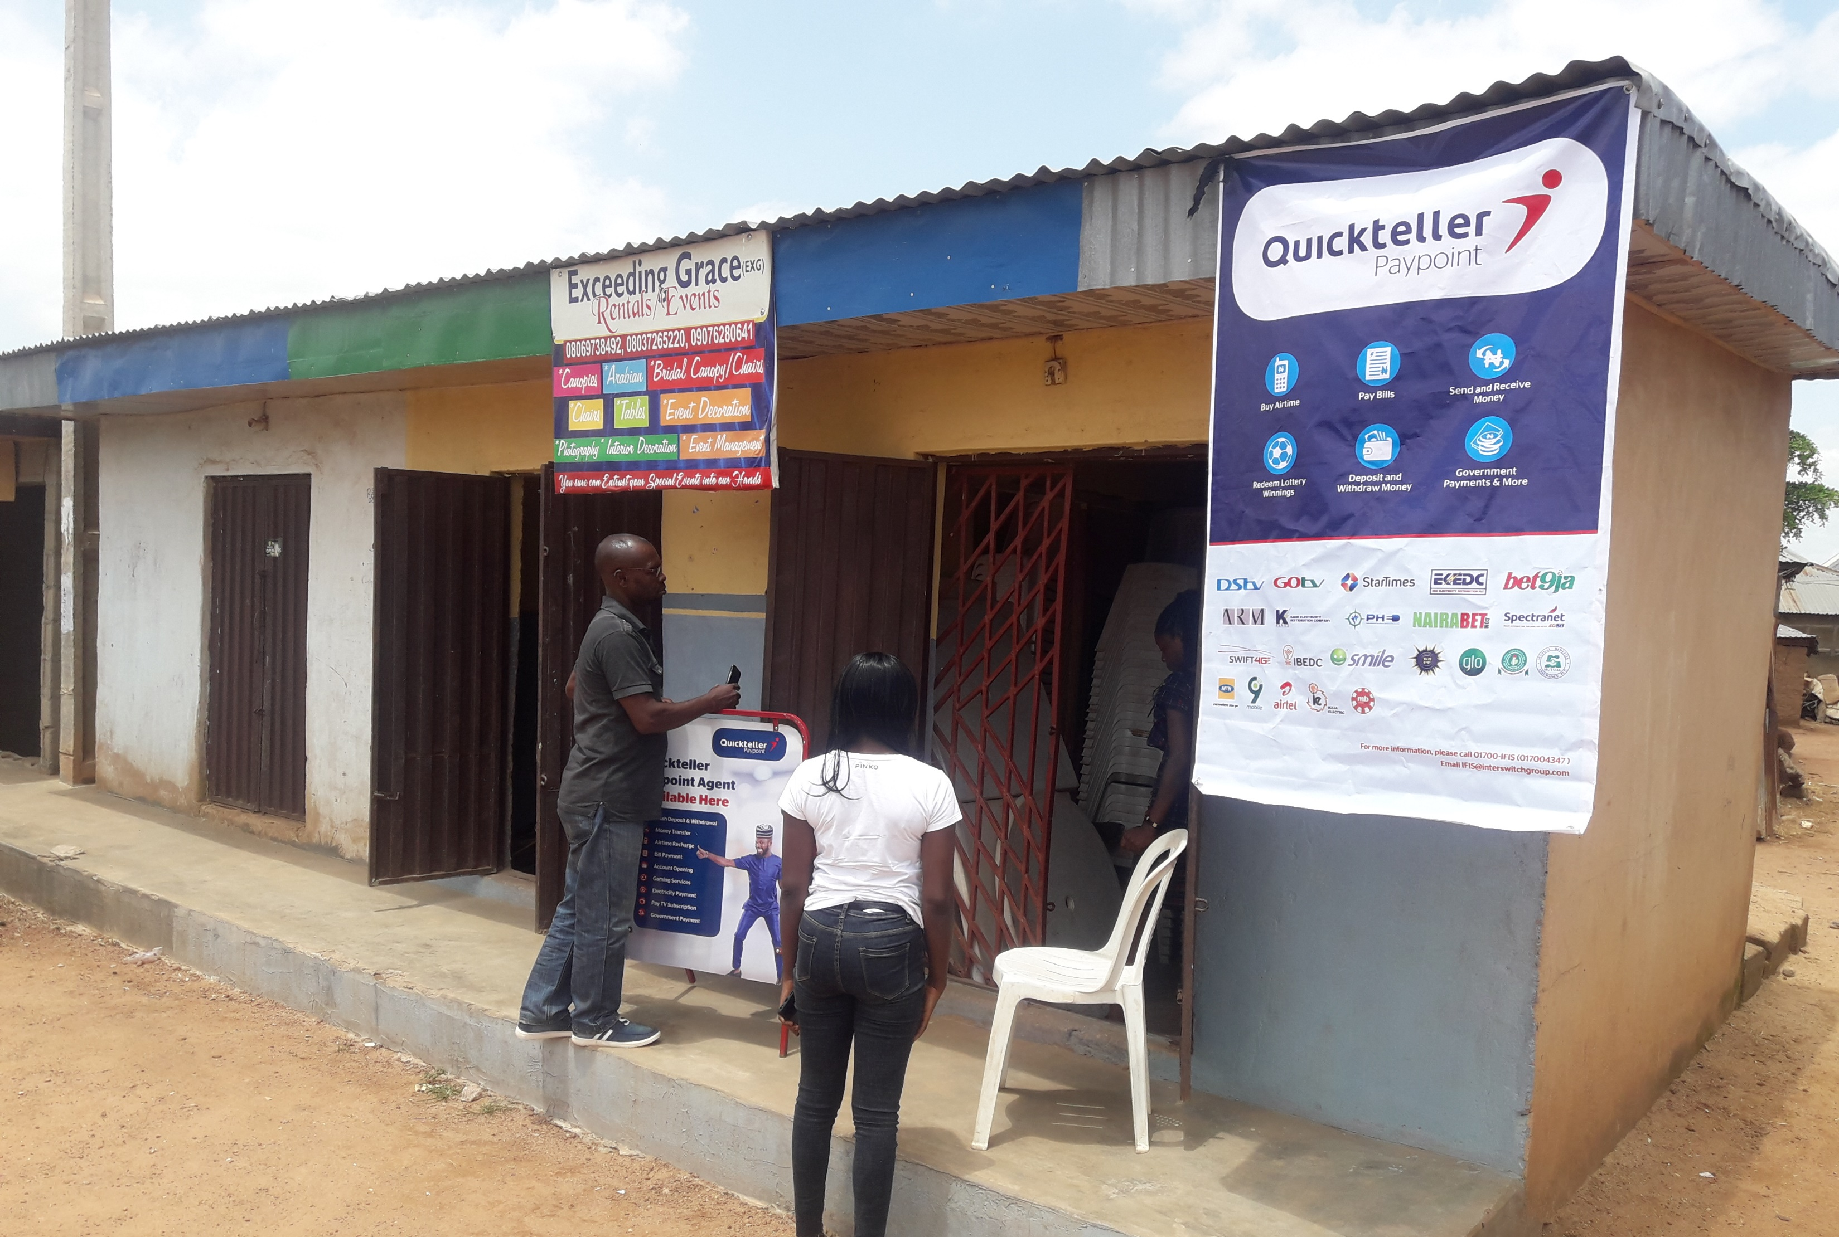
RECOMMENDATIONS
Majority of agents are concerned for their safety and that of their clients. There needs to be more support in terms of empowering agents with the knowledge to protect themselves and their clients, as well as the provision of PPEs to ensure agents can provide financial services safely
There is a need for standardisation of safety messages amongst agents to avoid communication of wrong messages to clients
With about 50% decline in average incomes for agents and about 80% of agents reporting some form of negative impact on the agency business, financial support for agents, particularly towards float management/financing have also become imperative for agents
There are several unmet needs which agents have shown capacity to deliver. Financial service providers(FSPs)/stakeholders should consider exploiting the agents’ capacity to extend more financial/non-financial services to users. These non CICO transactions and distribution of CCTs are particularly relevant to profitability in rural areas

Slide 18
Thank You

